Slide 1
MLDS 2017 Spring
HW2 - Seq2seq & Attention
mldsntu2017@gmail.com

Slide 2
Outline
Introduction : Video Caption Generation
Sequence-to-sequence based model : S2VT
Training Tips
Attention
Schedule Sampling
Beamsearch
How to reach the baseline ?
Format & Submission Rules
Dataset
Rules & Format
Notes:
===戴===
Introduction
Seq2seq : S2VT
===施&陳===
Training Tips
===棋&袁===
How to reach the baseline?
Format Submission & Rules = testing時間，兩份run.sh格式 , 評分方式（ranking included）, 互評表單連結,禁止使用pre-trained model
===========
我會負責和各位確認報告內容

Slide 3
Video Caption Generation
Input: A short video
Output: The corresponding caption that depicts the video
(There are some demos later!!)
There are several difficulties including:
(1) Variable length of I/O
(2) Distinct attributes of videos
(In this task, CNN features will be provided!)

Slide 4
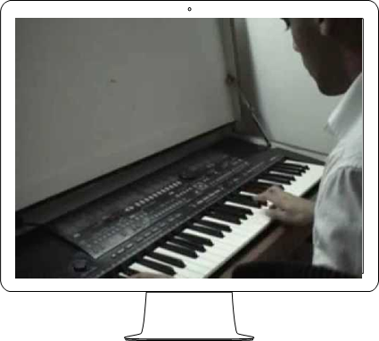
Video Caption Generation - Example
Input:
Output:
a man is playing a song on the piano .

Slide 5
Sequence-to-Sequence Based Model: S2VT
You can refer to the following paper for detailed info:
http://www.cs.utexas.edu/users/ml/papers/venugopalan.iccv15.pdf
The original task includes CNN and LSTM, but you can only focus on the structure of LSTM, since the CNN features will be provided.

Slide 6
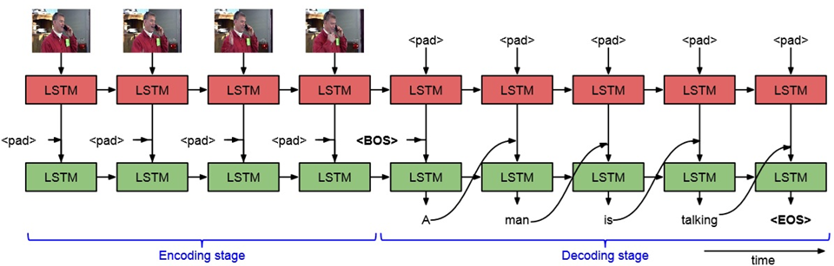
Sequence-to-Sequence Based Model: S2VT
The LSTM structure

Slide 7
Sequence-to-Sequence Based Model: S2VT
There are 2 LSTM stacks, the upper one is for encoding, and the bottom one is for decoding.
Encoding stage:
features→LSTM1→state h_{t}
Decoding stage:
state h_{t}→LSTM2→word y_{t}
Parameter sharing between 2 LSTM stacks can help reduce the complexity.
(Remember to use variable scope in Tensorflow!)

Slide 8
Sequence-to-Sequence Based Model: S2VT
Text Input
One-hot Vector encoding
(a.k.a. 1-to-N coding, where N is the size of the vocabulary)
e.g.
neural = [0, 0, 0, …, 1, 0, 0, …, 0, 0, 0]
network = [0, 0, 0, …, 0, 0, 1, …, 0, 0, 0]

Slide 9
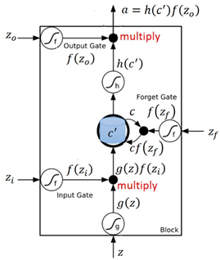
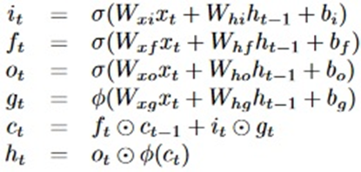
Sequence-to-Sequence Based Model: S2VT
LSTM unit

Slide 10
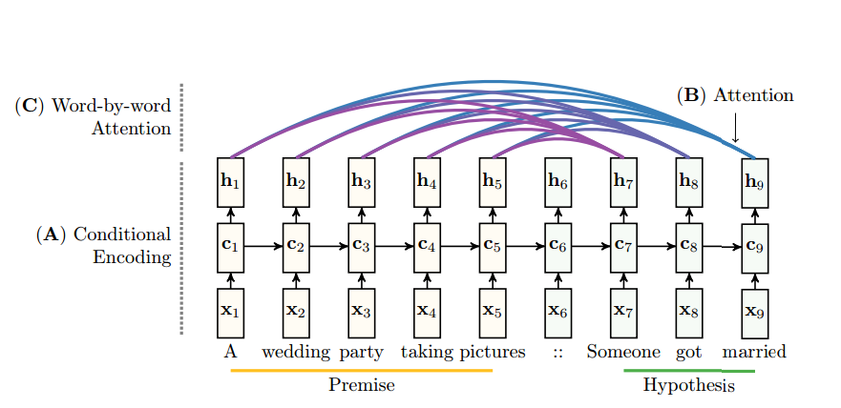
Training Tips
Attention Model
https://arxiv.org/pdf/1509.06664.pdf
http://www.aclweb.org/anthology/D15-1166

Slide 11
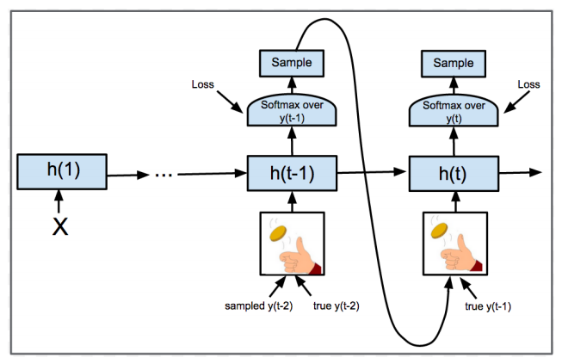
Training Tips
Schedule Sampling
https://arxiv.org/abs/1506.03099

Slide 12
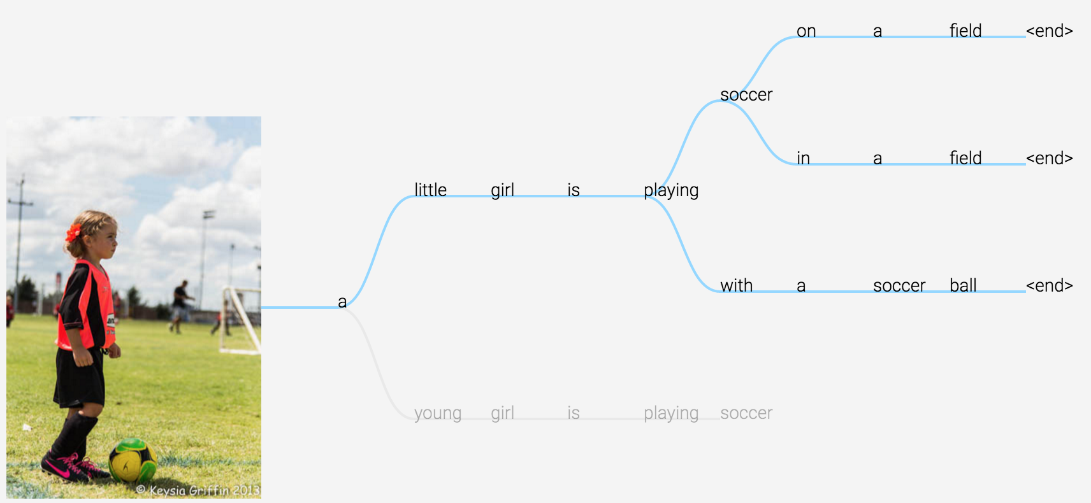
Training Tips
Beamsearch

Slide 13
Training Tips
Beamsearch
Demo :
http://dbs.cloudcv.org/captioning
Normal beamsearch : (Groups=1)

Slide 14
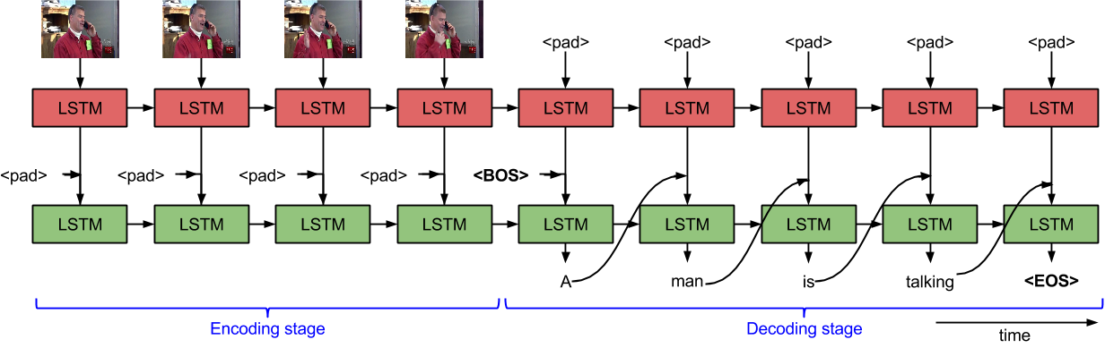
How to reach the baseline?
S2VT model :
Training Epoch = 2000 - AdamOptimizer
LSTM dimension = 256 - Training time = 72 mins, by using 960 TX
Learning rate = 0.001
vocab size = 3000
Baseline BLEU@1= 0.25 (Captions Avg.)
http://www.cs.utexas.edu/users/ml/papers/venugopalan.iccv15.pdf

Slide 15
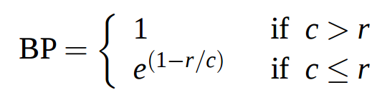
Evaluation - BLEU@1
Precision = correct words / candidate length
where c = candidate length, r = reference length
BLEU@1 = BP * Precision
http://www1.cs.columbia.edu/nlp/sgd/bleu.pdf

Slide 16

How to reach the baseline?
Demo :
Ground Truth : a person is slicing a tomato
Prediction : a man is slicing a tomato pieces
BLEU@1 : 1 * 5/7 = 0.714

Slide 17
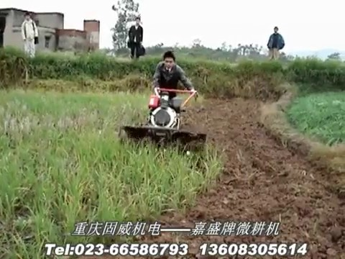
How to reach the baseline?
Demo :
Ground Truth : a man is mowing a lawn
Prediction : a man is riding a man on a woman is riding a motorcycle
BLEU : 1 * 4/13 = 0.308

Slide 18
Homework 2 package
MSVD Dataset :
training_data/ : 1450 films’s frame feature
testing_data/ : 50 public testing film’s frame feature
Dimension of each frame = 80*4096
training_label.json : 1450 films’s id and corresponding captions
testing_public_label.json : 50 public testing films’s id and captions
testing_id.txt : the example file will input to testing script
Evaluation tool :
bleu_eval.py
usage : python bleu_eval.py <candidate_sentence> <reference_sentence>
Download link : http://speech.ee.ntu.edu.tw/~yangchiyi/MLDS_hw2/MLDS_hw2_data.tar.gz

Slide 19
Submission on Github
Only Python with Tensorflow r1.0 (TAs will run your code in Tensorflow-only environment).
Deadline: 4/27(Thu.) 23:59:59 (UTC+8)
MLDS2017/hw2 should contain all the things you use. Ex. run.sh, model, report.pdf, etc. If some files are too big, upload to your cloud and write a script to download them. Remember to call the download script in run.sh.
run.sh must output in 10 minutes.
Usage: bash run.sh [testing id file] [feature path]

Slide 20

Output format
Command : ‘ bash run.sh <testing_list.txt> <feature path> ‘
Your captions of videos should be saved as a json file named ‘ output.json ’
Format of output.json : list of dictionary with two keys ‘caption’ and ‘id’
Your caption should be separated by the space among words and no need to output ‘<EOS>’ or ‘ . ‘
output.json should be placed at the same path as run.sh
Every steps including downloading your model and testing process should be written in run.sh

Slide 21
Submission on Github
You must create two branches master and best.
master stores the model by using only S2S with attention (external data is not allowed)
best stores your best model. If your best model is the same as your baseline model, just copy all files in master to this branch.
The format is mentioned in the previous slide.
You have to specify the best performance you achieved by using only S2S with attention in the experiment part of your report.

Slide 22
Grading Policy (30%)
Format 2%
Code 4% (S2S 2% + attention 2%)
Baseline 4% (public 2% + private 2%)
Report 15%
各組互評 5%
Bonus
互評前三名 (5% 3% 1%)
You have to present how you beat other teams to get bonus.
限時任務 1%

Slide 23
What report should cover?
Environment (1%)
Ex. OS, CPU, GPU, Memory, libraries you used and version, etc.
Model description (3%)
How do you improve your performance (5%)
Experiment settings and observation (5%)
Team division (1%)
No more than 4 pages
Please written in Chinese (unless you don’t know how to type Chinese)

Slide 24
Other Policy
Late policy: 30% off per day late afterwards. [Delay form will be announced afterwards]
No plagiarism is allowed.
Use the given data only, except for pre-trained word embedding (you should specify the source in your report).

